Slide 1
Overview of Data Science
Cayla Burch
CTEC 298
Professor Bemley

Slide 2
Introduction
Data science is a field that involves other disciplines to focus on one study. Data science can include programming, statistics, analytics, data mining, data visualization, machine learning, and other related disciplines.
CTEC 298 is an extension of CTEC 128 in regards to using additional tools and processes to gain more valuable and actionable insights from data

Slide 3
Summary of CTEC 128 Paper
The topic of the project was Homeownership.
The purpose of my CTEC 128 project is to examine the different factors that contribute to homeownership and to analyze which factors contribute the most in home buying.
The data sources used in my project were datasets from the American Housing Survey (AHS) and the International Monetary Fund (IMF) to evaluate factors related to homeownership in the United States and in other countries around the world.

Slide 4
Description of CTEC 298 Material Submitted
For week 1 and 2, the activities were the Dataquest Analyst Tutorials. The tutorials included Python Missions, programming in Python, variables and data types, lists and for loops, conditional statements, dictionaries and frequency tables, and fundamental functions.
For weeks 2 and 3, the activities were the installation of Jupyter Notebook, GitHub installation, and the Matplotlib tutorial.
For week 4, the activities were the Panda, Numpy, and Matplotlib assignments.
For weeks 5 and 6, the activities were the six plots, the tableau install, and the tableau plots.

Slide 5
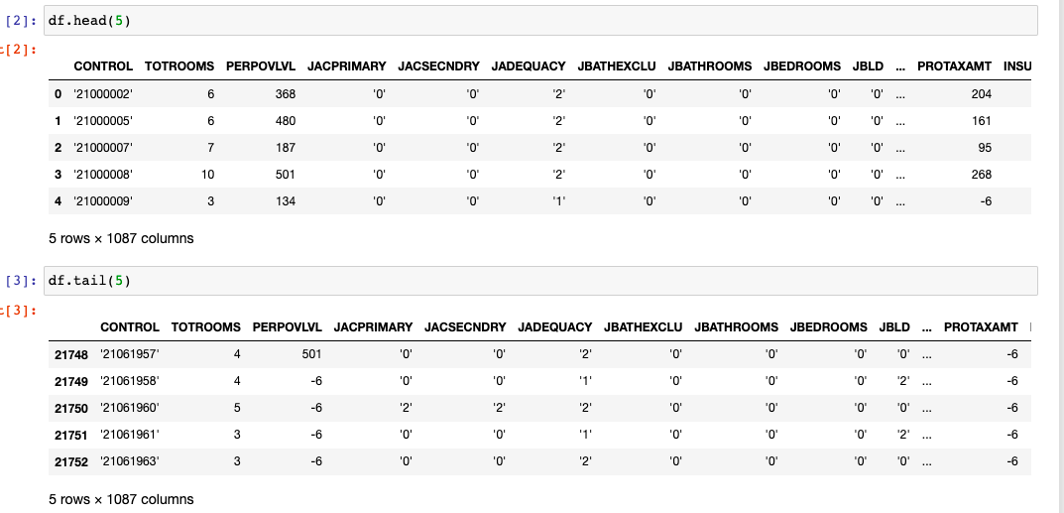
Original Dataset (Head & Tail)

Slide 6
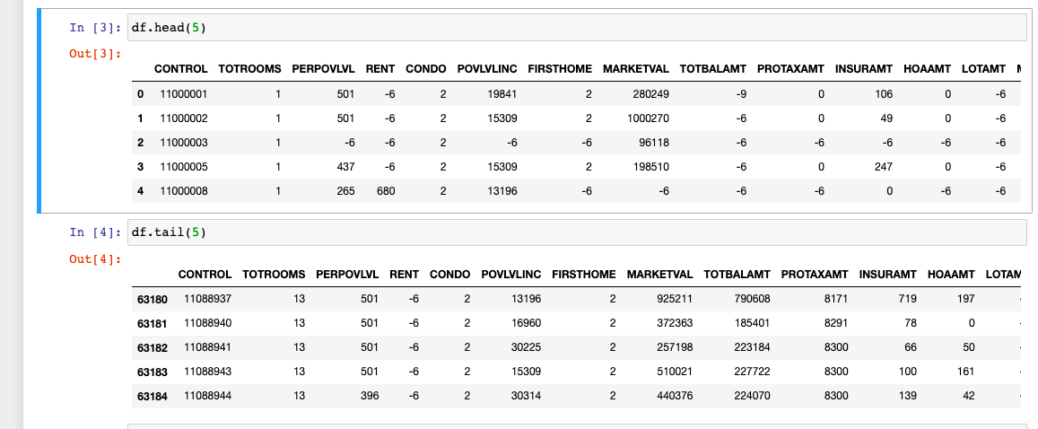
Wrangled Dataset

Slide 7

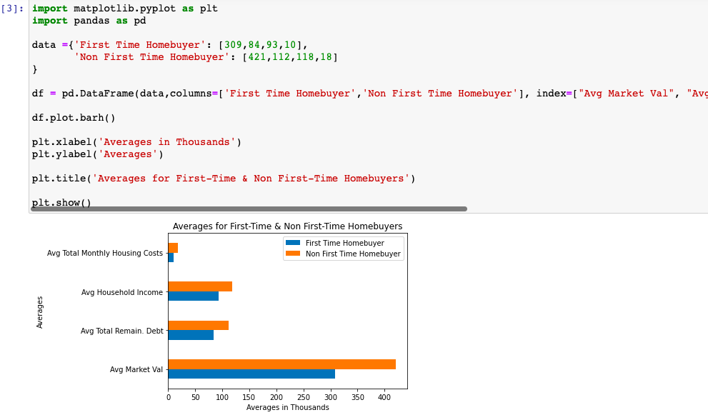
Plot Deliverable (1)
In this data visualization, I chose to represent the averages of first time homebuyer and non first time homebuyers.

Slide 8
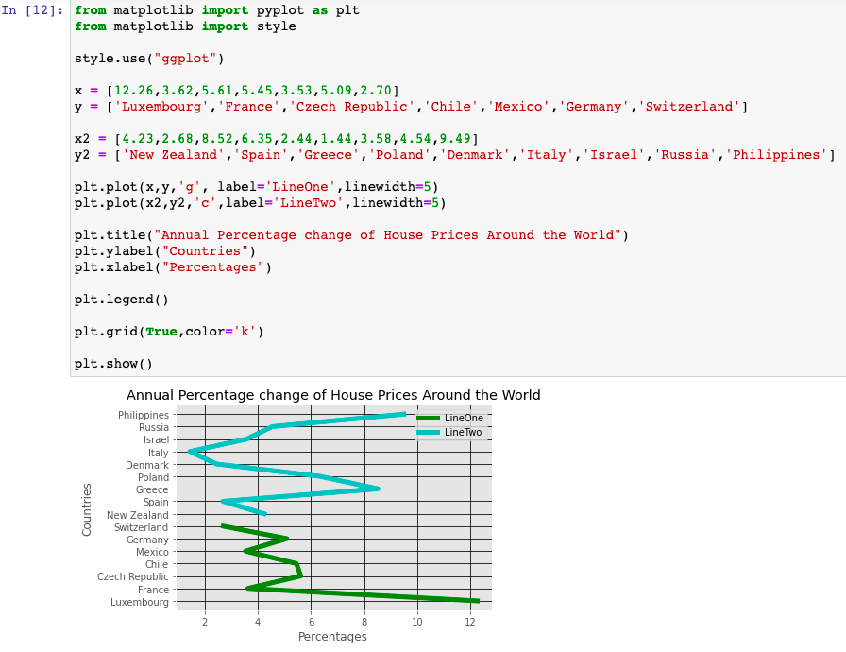
Plot deliverable (2)
In this data visualization, I chose to represent the annual percentage change of house prices around the world.

Slide 9
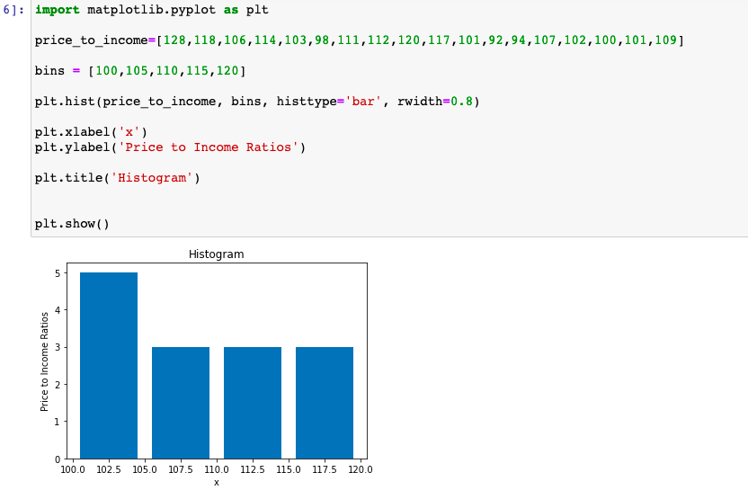
Plot Deliverable (3)
In this data visualization, I chose to represent the price to income ratio for different countries.

Slide 10
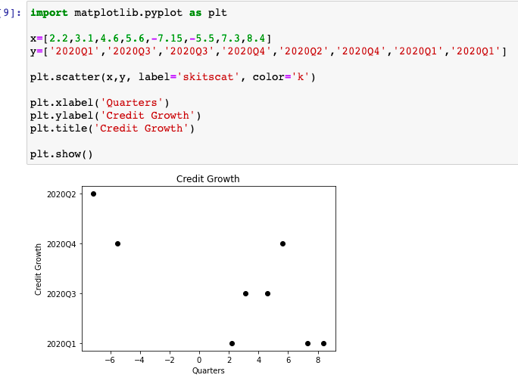
Plot Deliverable (4)
In this visualization, I chose to represent credit growth in annual percentage change of different countries in different quarters of 2020.

Slide 11
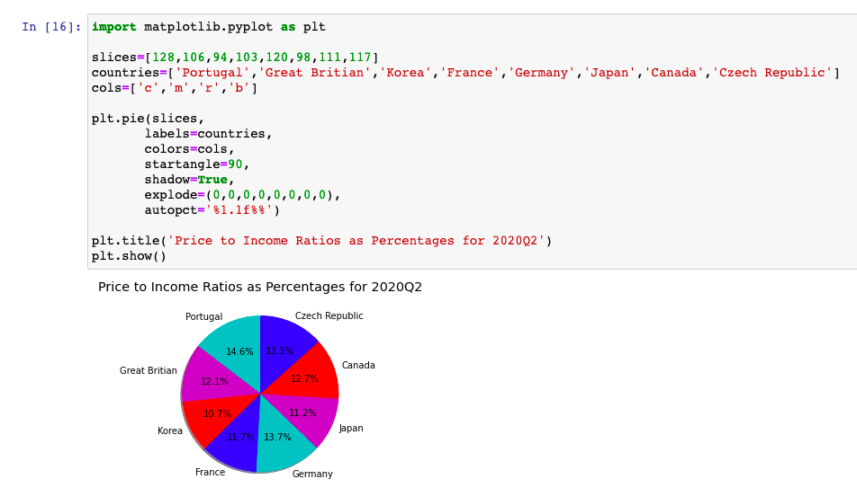
Plot Deliverable (5)
In this data visualization, I chose to represent price to income ratios as percentages for the second quarter in 2020 in different countries.

Slide 12
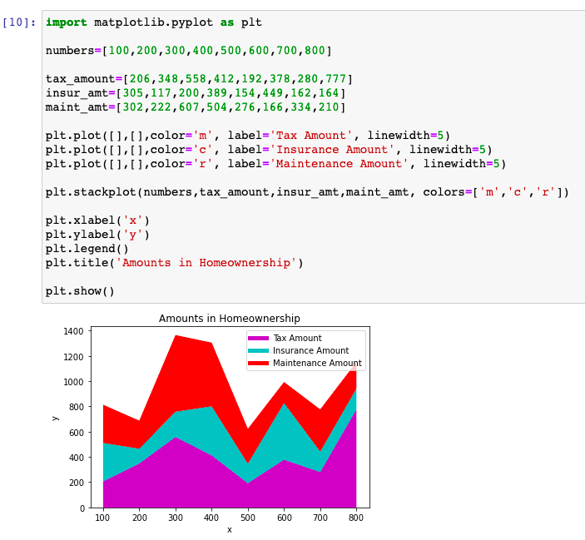
Plot Deliverable (6)
In this data visualization, I chose to represent amounts in homeownership such as total tax amount, insurance amount, and maintenance amounts. The y axis is the actual total values in thousands.

Slide 13
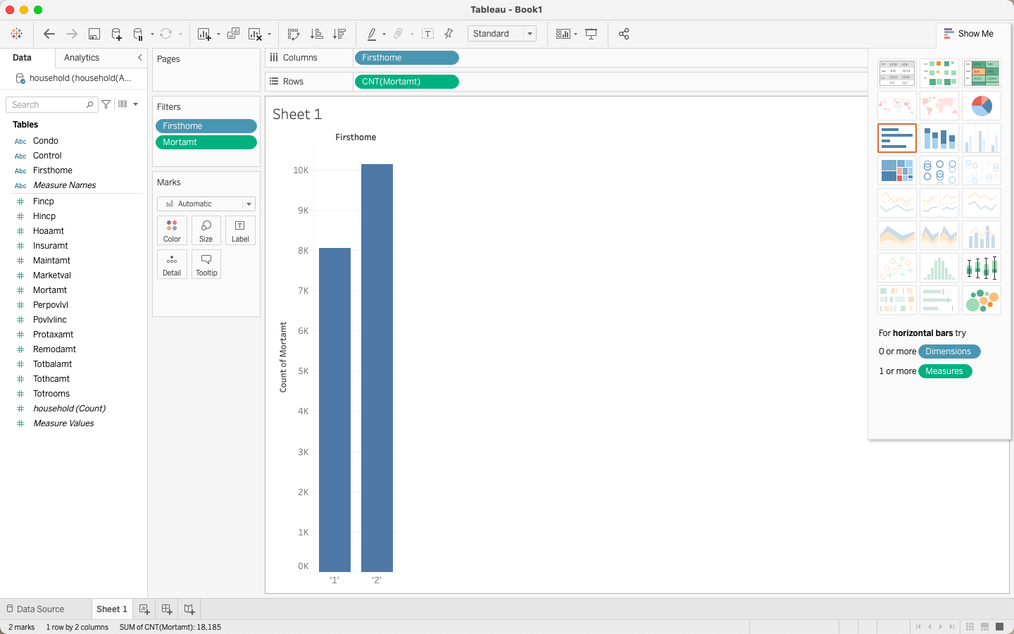
Tableau Plot 1
This first Tableau visualization is a bar graph. I chose to represent the mortgages for first time homebuyers which represented in the graph by the number “1” and non first time homebuyers which represented by the number “2” on the x axis.

Slide 14
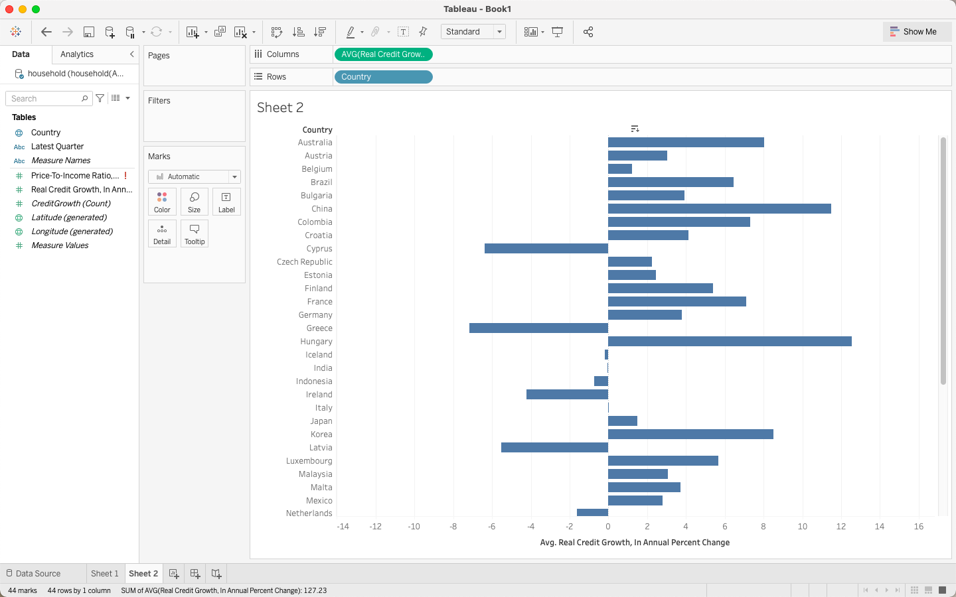
Tableau Plot 2
The second Tableau visualization is another bar graph, but is displayed horizontally. I chose to represent the average credit growth in annual percentage change.

Slide 15
Conclusion
The goal of each assignment for CTEC 298 was to become more knowledgeable about different Python based programs.
This class demonstrated how we can create visualizations from our CTEC 128 data.

Slide 16
Thank You

